Slide 1
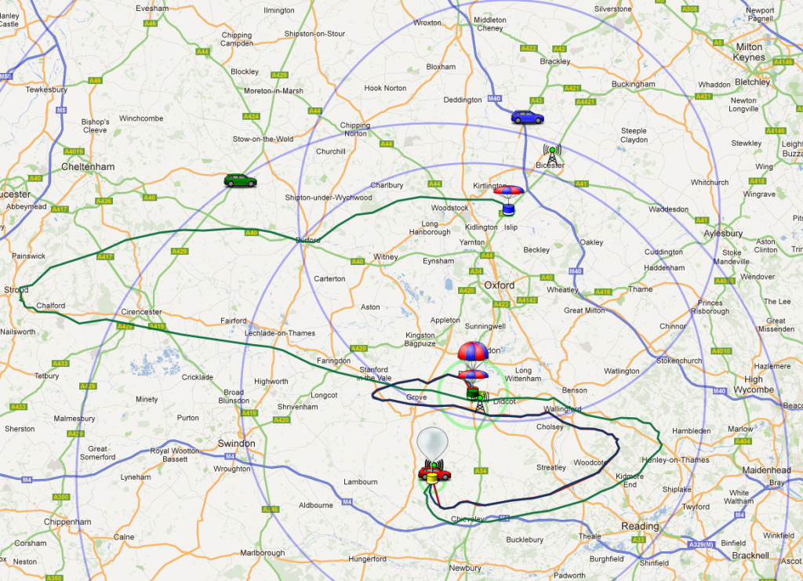
Getting On The Map
Telemetry Database
Map
dl-fldigi
habitat
Payload Document

Slide 2
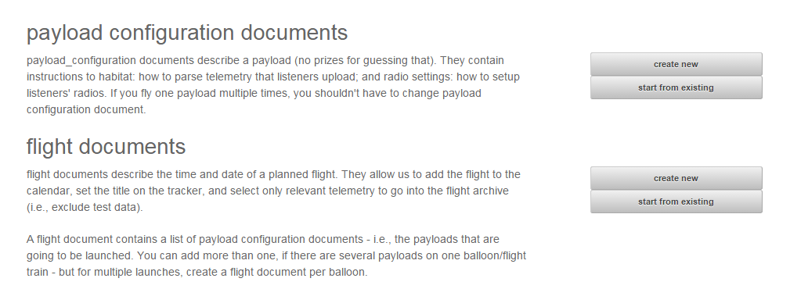
genpayload
http://habitat.habhub.org/genpayload/

Slide 3
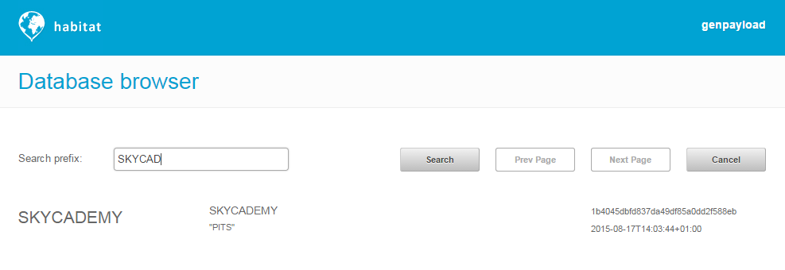
Start From Existing

Slide 4
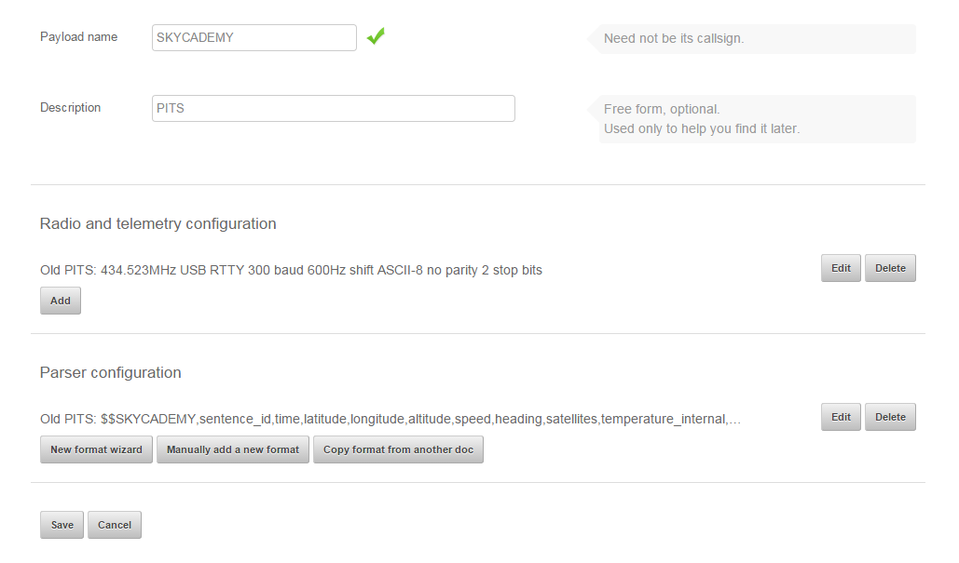
Getting On The Map

Slide 5
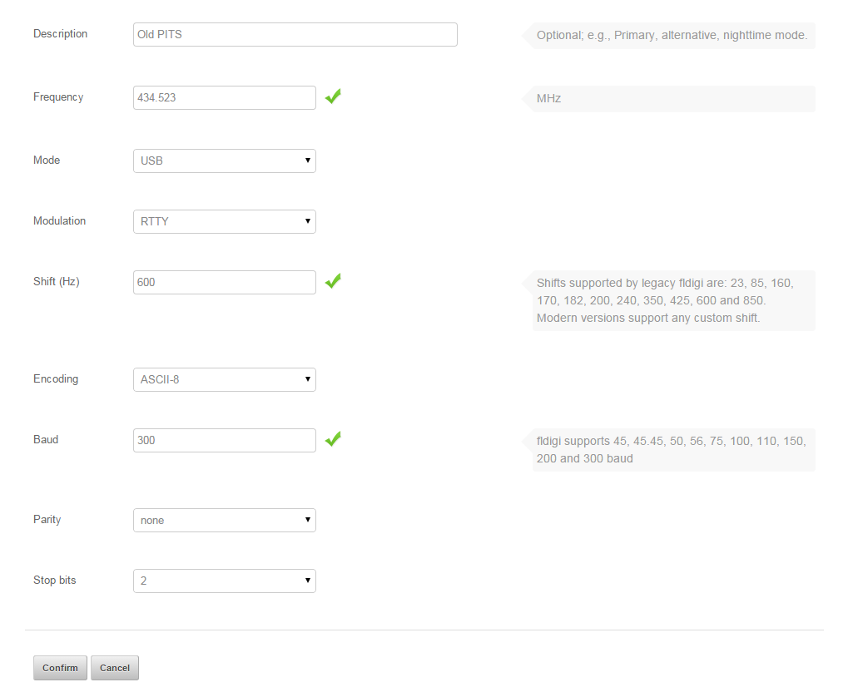
Transmission (RTTY Only)

Slide 6
Tracker Sentence Format
$$CLOUD9,2,08:39:59,51.95029,-2.54437,00130,0,0,4,31.4,0.0,0,26.9,999.1,27.1*ABCD
$$ - starts each sentence
CLOUD9 - Payload ID
2 - Sentence Counter
08:39:59 - Time (UTC)
51.95029 - Latitude
-2.54437 - Longitude
00130 - Altitude
0 - Horizontal Speed
0 - Horizontal Direction
4 - Number of GPS Satellites In Use
31.4 - Internal Temperature
0.0 - Battery Voltage in Volts (zero if running on USB power)
0 - Battery current consumption in mA
26.9 - External Temperature (if BMP180 pressure/temperature sensor added)
999.1 - Air Pressure (if BMP180 pressure/temperature sensor added)
27.1 - External Temperature (if DS18B20 temperature sensor added)
ABCD - CRC Checksum

Slide 7
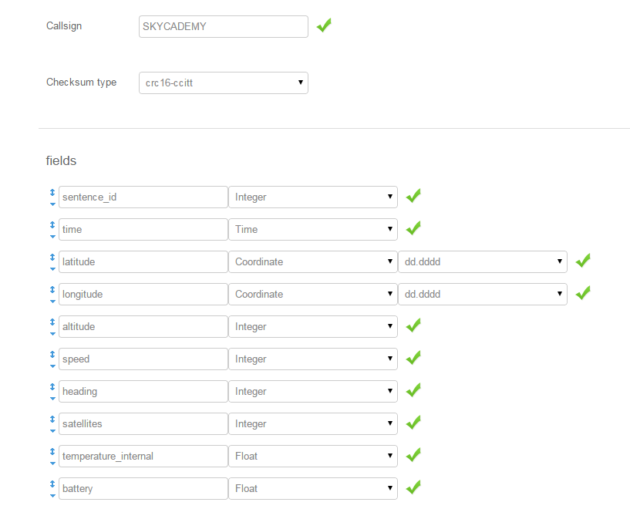
Payload Doc Sentence Format

